Slide 1
Market Failures and
the Role of the Government
Externalities

Slide 2
In this module, look for the answers to these questions:
Define:
What is an externality?
What are private costs and private benefits?
What are social costs and social benefits?
Explain:
Why do externalities make market outcomes inefficient?
What public policies aim to solve the problem of externalities?
***How can people sometimes solve the problem of externalities on their own?
Examine:
What do public policies not always work?
***Why do private solutions not always work?

Slide 3
Efficient Market
Market is at equilibrium.
No surplus (Qs>Qd) , no shortage (Qd>Qs)
The consumer and the producers are the only parties affected by the transaction.
Consumers decide what to buy and how much to buy based on their own private cost (price) and private benefit (what the consumer believes the product is worth as represented by the demand curve)
Suppliers decide what to sell based on their own private cost (cost as represented by the supply curve)and private benefit (the revenue, which is the equilibrium price, the supplier receives for each unit sold

Slide 4
Inefficient Market: Externality
However, sometimes, the consumers and producers are not the only parties affected by the transaction between the two.
There are sometimes external costs or benefits of their actions, so the market outcome is not efficient
We call that Externality: the uncompensated impact of one person’s actions on the well-being of a bystander.
Another way to explain it: a side effect or consequence of an industrial or commercial activity that affects other parties without this being reflected in the cost of the goods or services involved, such as the pollination of surrounding crops by bees kept for honey.

Slide 5
Externalities
Externalities can be negative or positive,
depending on whether impact on bystander is adverse or beneficial.
    Concert in the park
    Neighbor’s kid practicing trumpet
    Guang chang wu late at night
    Roommate that cleans her area well
    Neighbors that keep their yard neat

Slide 6
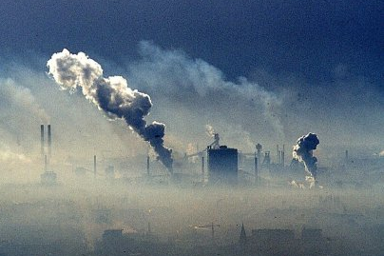

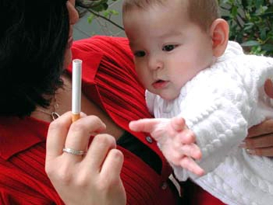

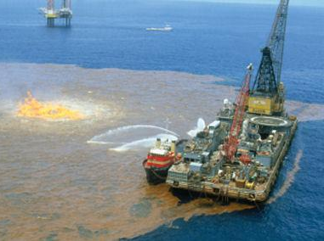
Negative Externalities
Notes:
Smog
Traffic

Slide 7
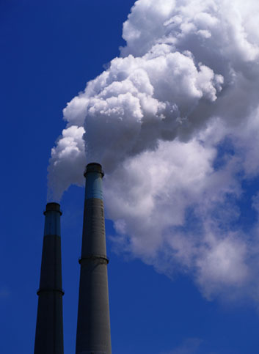
Examples of Negative Externalities
Air pollution from a factory
The neighbor’s barking dog
Late-night stereo blasting from
the dorm room next to yours
Noise pollution from
construction projects
Health risk to others from
second-hand smoke
Talking on cell phone while driving makes
  the roads less safe for others

Slide 8
Externalities
Social cost = private cost + external Cost
Social benefit = private benefit + external benefit
Positive Externality: social benefit > private benefit
Negative Externality: social cost > private cost

Slide 9
Other Types of Market Failure
OTHER market failure types include:
  common property resources
  public goods
  government failure (DP1 or later)
  Imperfect market (DP1 or later)

Slide 10
Inefficient Market (Market Failure) including， but not limited to the following:
Long-lasting surplus
Long-lasting shortage
In cases of long-lasting surplus or shortage, the market fails to correct itself, such as in the case of command-and-control (planned) economy, where the government fixes prices.
Externalities
  Private cost and benefit
  External cost and benefit
  Social cost and benefit

